Slide 1
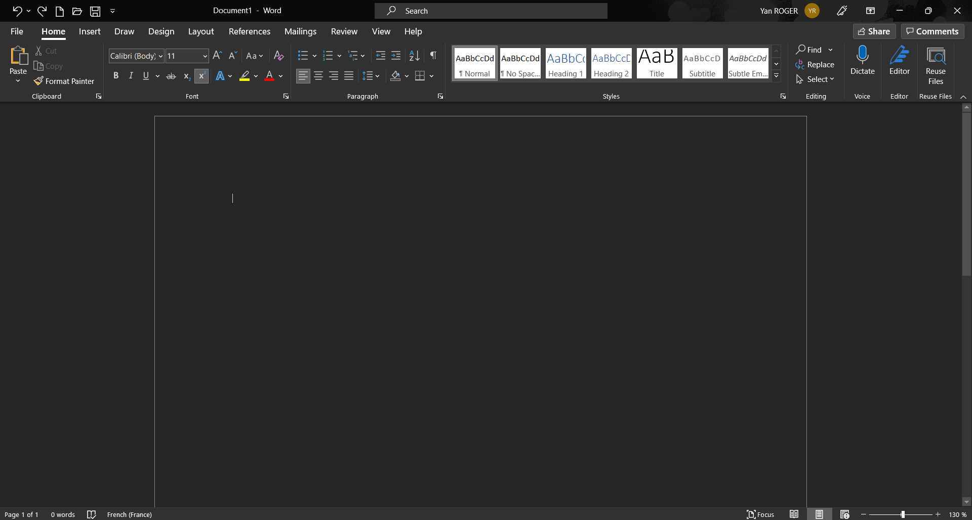
Scrollbar

Slide 2
Save
Repeat
Cancel

Slide 3
The other tabs
The active tab
The groups

